Slide 1
Simple and Multiple Linear Regression Analysis of Life Expectancy
10/29/2024

Slide 2
Executive Summary
Objective
Analyze the relationship between life expectancy and vaccination rates (DTP and measles) across countries using 2020 UN data.
Question
Are higher vaccination rates correlated with increased life expectancy across different countries?
Results
Found unexpected negative associations between vaccination rates and life expectancy.
Discussion
The unexpected negative correlation suggests possible other factors, such as healthcare quality or socio-economic conditions.
Performed a deeper exploration of socioeconomic and health-related variables.

Slide 3
Analysis Background
Dataset
The analysis utilized United Nations Human Development Data for 2020 consisting of 70 descriptive variables for 197 countries.
The data set includes a diverse set of variables pertaining to education levels, social disparities, economics, healthcare, and other country-level descriptors.
Background
Life Expectancy is one of the most important indicators of a population’s overall health, and it refers to the average number of years a person is expected to live based on current mortality rates.
In simple terms life expectancy is the average number of years a newborn is expected to live if the current mortality rates remain constant throughout their lifetime.
Life expectancy was chosen as the outcome variable as it is a key indicator of a country’s overall level of development and health outcomes for its citizens.
Approach
Both simple and multiple linear regression were used to analyze the relationship between diphtheria and measles vaccination rates and life expectancy at the country level.

Slide 4
Description of Variables
Key Variables
Variable | Rationale for Inclusion
DTP Vaccination numbers | Number of DTP vaccinations (per 100 population). DTP is a combination of vaccines that protects against three infectious diseases: diphtheria, tetanus, and pertussis.
Measles Vaccination numbers | Number of measles vaccinations (per 100 population) pop: Total population
Outcome Variable
Variable | Rationale for Inclusion
Life Expectancy | Life expectancy serves as a strong proxy measure for overall public health. Thus, life expectancy is used as a proxy in this analysis to evaluate the strength of the relationship between the explanatory variables and public health.

Slide 5
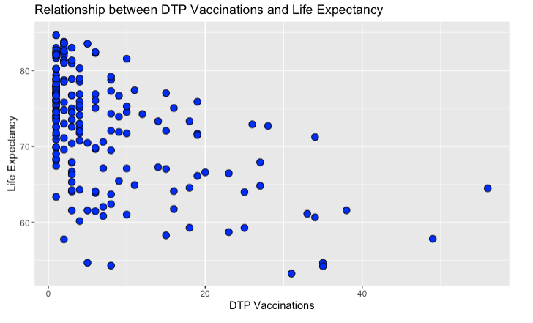
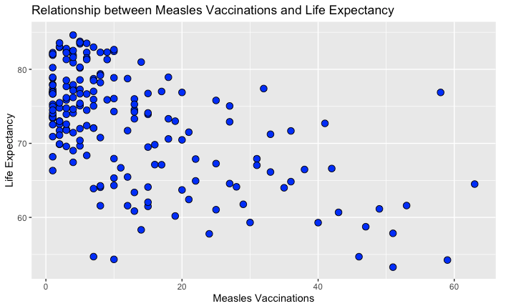
Initial Linear Relationships
Relationship between Diphtheria/Measles Vaccinations and Life Expectancy
A negative linear relationship can be observed in the scatterplots for both diphtheria and measles vaccinations against life expectancy.

Slide 6
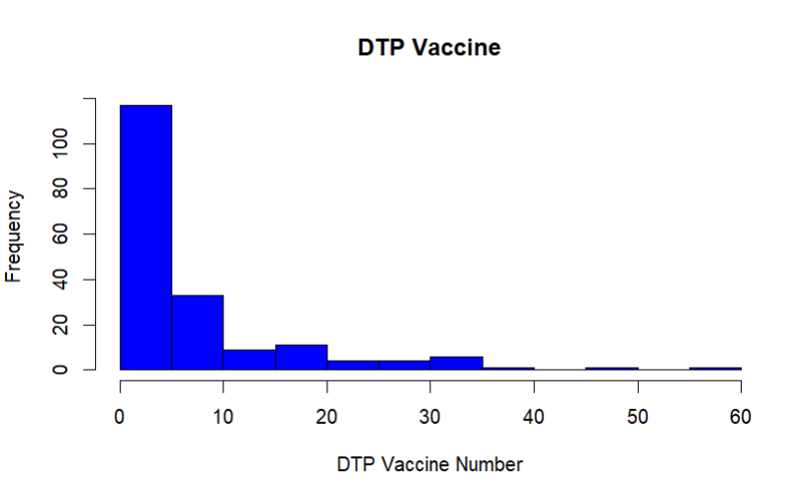
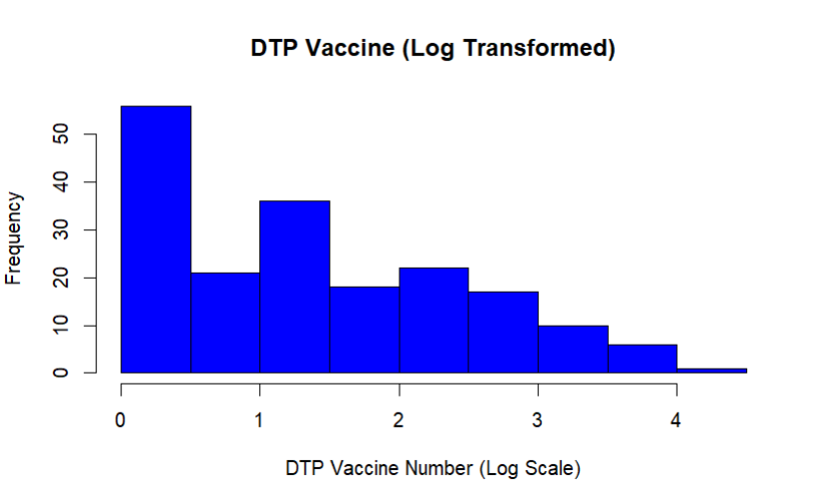
Distribution of Measles Vaccinations
Diphtheria (DTP) Distribution Characteristics
The distribution of DTP vaccination rates and life expectancy is right skewed.
Log transformation improves the distribution enough to be used in linear regression, however the skew is still present, potentially impacting interpretability of the final model.

Slide 7
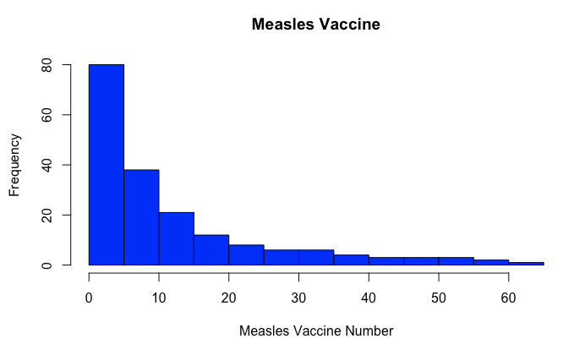
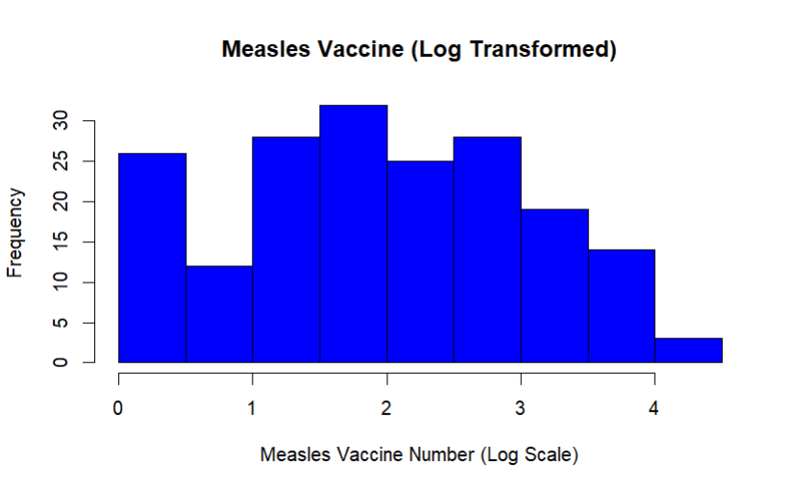
Distribution of Diphtheria Vaccinations
Measles Distribution Characteristics
The distribution of the DTP and Measles vaccine is also right skewed.
Log transformation improves the distribution enough for it to be used in linear regression despite it not being perfectly normal.

Slide 8
Vaccinations Simple Linear Regression Results
DTP Vaccinations
Coefficient is -3.47 , with a p-value of 1.22e-15.
The model suggests that a 1 log unit increase of DTP vaccinations is associated with a decrease of 0.035 years in life expectancy.
The p-value suggests that the relationship with life expectancy is statistically significant.
Measles Vaccinations
Coefficient is -3.29 , with a highly significant p-value of 2.99e-14.
This model suggests that a 1 log unit increase in measles vaccinations is associated with a decrease in life expectancy by 0.033 years.
The p-value suggests that the relationship with life expectancy is statistically significant.

Slide 9
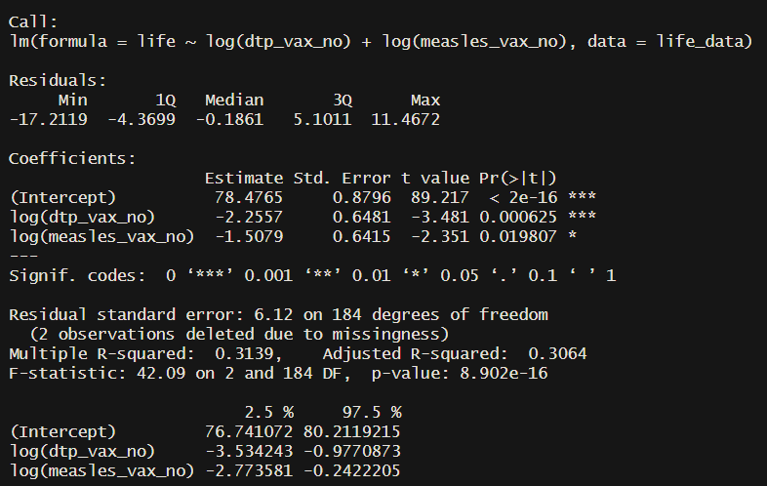
Vaccinations Multiple Linear Regression Results
DTP + Measles
The DTP Coefficient is -2.26, with a p-value of 0.0006.
The Measles Coefficient is -1.51 with a p-value of 0.0198.
The overall p-value of the model is 8.902e-16.
Interpretation
The overall multiple R2 is 0.3139.
The strong individual and overall p-values suggest that the relationship between vaccination rates and life expectancy is statistically significant.
A R2 of only 0.3139 indicates that vaccination rates are not able to fully explain changes in life expectancy in isolation.

Slide 10
Multiple Linear Regression - Analysis of Additional Variables
Analysis Objective
The analysis aims to identify and measure potential relationships between a set of social, economic, and public health related variables and a country’s average life expectancy using multiple linear regression.
Variable Selection Approach
Variables were considered for analysis based on their likelihood to have a significant relationship with the outcome variable - life expectancy.
Highly correlated variables were excluded from the analysis. (Ex. total population and the various population variables stratified by age).
Confounding variables were included intentionally to add depth and improve the estimation of possible relationships. (Ex. Total GDP, Depth of Food Deficit)
Final Explanatory Variables
Total Population, Total Fertility Rate, Infant Mortality, Urban Population Percentage, Tuberculosis Incidence, Mean Age, Mean Years of Schooling, Depth of Food Deficit, Total GDP, Migration

Slide 11
Additional Explanatory Variables
Explanatory Variables
Variable | Rationale for Inclusion
Total Population | Variance in population numbers could have an impact on life expectancy via a variety of economic and social factors.
Total Fertility Rate | The number of children a woman has could acutely affect individual life expectancy and could also serve as a signal for wider societal dysfunction.
Infant Mortality | Infant mortality likely significantly impacts life expectancy measures as naturally the associated low age of death would substantially affect the average.
Urban Population | Variation in urban population percentages could contribute to variability in life expectancy through disease rates, crime prevalence, and overall economic opportunity.
Prison Population | Higher prison population could be indicative of increased violent crime; prisons can also serve as a vector to spread disease. Both of which could have a significant impact on life expectancy.
Tuberculosis Incidence | Tuberculosis is a somewhat preventable disease that like Malaria has the potential to influence life expectancy in a myriad of ways.
Median Age | Median age is likely to be a confounding variable for many of the explanatory variables included in this analysis; as such it has been incorporated to add depth and validity to drawn conclusions.
Mean Years of Schooling | Highly educated individuals are probably likely to be more health conscious; thus, mean years of schooling has been included in the analysis to evaluate the statistical strength of the relationship between it and life expectancy.

Slide 12
Additional Explanatory Variables
Explanatory Variables
Variable | Rationale for Inclusion
Depth of Food Deficit | Naturally if a country has less food its people are probably more likely to be malnourished, increasing risk of disease and death and contributing to reduced life expectancy measures.
Total GDP | This variable represents the economic strength of individual countries; in this case the hypothesized relationship is that economic strength facilitates better healthcare and lifestyles for citizens, improving life expectancy.
Migration | Higher rates of migration could serve as an additional vector for communicable disease; on the other hand, high migration rates could indicate a desirable country to live in economically.
Outcome Variable
Variable | Rationale for Inclusion
Life Expectancy | Life expectancy serves as a strong proxy measure for overall public health. Thus, life expectancy is used as a proxy in this analysis to evaluate the strength of the relationship between the explanatory variables and public health.

Slide 13



Results
Analysis Hypotheses
Modeling Approach
Significant Results
Gradient boosted decision tree model (XGBClassifier) demonstrated the best performance
.76 ROC AUC
Better than random but needs improvement
Null
The set of selected variables does not significantly contribute to changes in life expectancy.
Alternative
At least one of the selected variables contributes significantly to changes in life expectancy.
Assumptions
Linearity
Multicollinearity
Heteroscedasticity
Normality of Residuals
Multiple Linear Regression
Multiple linear regression was applied to a final set of variables after adjusting for multicollinearity.
Significant Variables
Negative - Fertility, Tuberculosis Incidence
Positive - Migration, Mean Years of Education, Food Deficit
R2 Value
The R2 of .8367 indicates the included variables explain about 84% of the change in life expectancy.
The problem was highly complex as it involved identifying a rare outcome from a large cohort of patients.
“Finding a needle in a haystack”
Reduce sparsity - feature rollup via string search or dictionary
Include clinical measurements – BMI, blood pressure, labs
More in-depth review of prior work, relevant clinical literature

Slide 14
Discussion
Summary
Findings
Contrary to expectations, vaccination rates (DTP, Measles) show a negative association with life expectancy
The relationship between immunization and life expectancy is more complex than initially assumed. While vaccinations are critical in preventing certain diseases, their overall impact on life expectancy can be influenced by a wide array of socio-economic and health factors.
Fertility and tuberculosis were identified as the most significant negative predictors, suggesting that public health challenges, particularly in lower-income countries, may overshadow the benefits of immunization.
Next Steps
Further exploration of confounding factors is needed, such as including more health indicators or improving data quality.
Investigate possible regional effects or socioeconomic conditions that drive the unexpected negative relationship with vaccinations.

Slide 15
References
1.Nations U. Data Reader’s Guide. United Nations Accessed October 28, 2024. https://hdr.undp.org/reports-and-publications/2020-human-development-report/data-readers-guide
2.Nations U. Documentation and Downloads. United Nations Accessed October 28, 2024. https://hdr.undp.org/data-center/documentation-and-downloads

